Slide 1


SOCIAL BUZZ

Slide 2


AGENDA:
Project recap
Problem
The Analytics team
Process
Insights
Summary

Slide 3

Social Buzz is a fast growing technology unicorn that need to adapt quickly to its global scale. Accenture has begun a s month POC focusing on these tasks:
An audit of Social Buzz’s big data practice.
Recommendations for successful IPO
Analysis to find Social Buzz’s top 5 most popular categories of content.
Project Recap

Slide 4
Identifying Key Opportunities in Content Performance
In today’s competitive digital landscape, organizations rely heavily on understanding user engagement to optimize their content strategy. However, raw reaction data often lacks the necessary structure and context to drive actionable decisions.
Why This Problem Matters:
For Business Strategy: Understanding which content categories resonate most with the audience ensures marketing resources are spent effectively.
For User Engagement: Prioritizing engaging content helps retain and attract users, increasing overall satisfaction.
For Scalability: Insights derived from this analysis provide a scalable framework for evaluating future content strategies.
Problem

Slide 5



AANDREW FLEMING
CHIEF TECHNICAL ARCHITECT
The Analytics team
MARCUS ROMPTOM
SENIOR PRINCIPAL
BRITHIKSHA NV
DATA ANALYST

Slide 6
Process
1
DATA UNDERSTANDING
2
DATA CLEANING
3
DATA MAODELLING
4
DATA ANALYSIS
5
UNCOVER INSIGHTS

Slide 7

Insights
1897 REACTIONS TO ANIMAL POSTS
16
UNIQUE CATEGORIES
JANUARY
MONTH WITH MOST POSTS

Slide 8
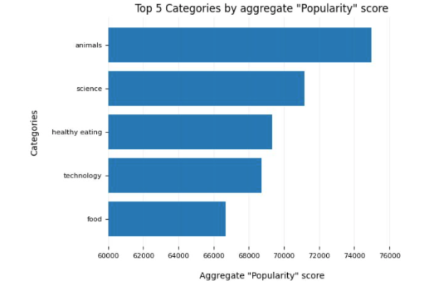

Slide 9
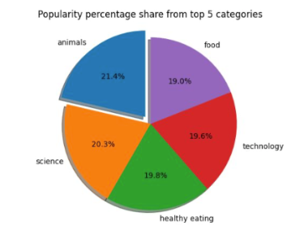
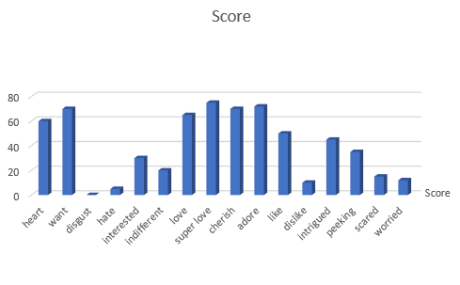

Slide 10

There are a total of 16 distinct content categories. Out of which Animal and Science categories are the most popular one.
4 type of content – Photo, Video, Gif and Audio,
Out of which people prefer photo and video.
May month has the highest number of posts.
Summary
Should focus more on the top 5 categories that’s animal, technology, science, healthy eating and food.
create campaign to specifically target those audiences
Need to maximize in the month of January, may and august as they number of posts in these months are the highest.

Slide 11
Thank you!
ANY QUESTIONS?

